Slide 1
Respiratory System
Year 11 Human Biology
ATAR
PowerPoint 9

Slide 2
SCSA Syllabus Reference
the exchange of gases between the internal and external environments of the body is facilitated by the structure and function of the respiratory system at the cell, tissue and organ levels
the efficient exchange of gases in the lungs is maintained by the actions of breathing, blood flow and the structure of the alveoli

Slide 3
Lesson Intention
To explore the structure and function of the respiratory system
To explore the mechanics of breathing and how the lungs are suited for gas exchange
To explore the process of gas exchange
To discuss the effects of lifestyle and environment on gas exchange

Slide 4
Success Criteria
describe the structure of the respiratory system components
describe the function of the respiratory system components
distinguish between inspiration and expiration
draw a labelled, annotated diagram of the sequence of events during inspiration and expiration (Pg 90, Fig 4.5)
explain how the structure of the lungs is suited to gas exchange
explain the process of gas exchange
draw a labelled annotated diagram showing the process of gas exchange in an alveoli (Pg 92, Fig 4.7)
identify short and long term consequences from lifestyle choices and environmental exposure
describe the effect these examples have on the respiratory system

Slide 5
Vocabulary
Epiglottis: a cartilage flap at the base of the pharynx that covers the trachea during swallowing.
Pharynx: the throat; the pharynx joins the mouth cavity to the oesophagus and larynx.
Larynx: the structure at the top of the trachea that contains the vocal cords.

Slide 6
Vocabulary
Trachea: the tube that takes air from the throat to the lungs.
Bronchi: two main airways.
Bronchiole: a very small air tube in the lung
Alveoli: air sacs in the lungs

Slide 7
Vocabulary
Diaphragm: a muscle that separates the chest from the abdomen.
Inspiration: breathing in
Expiration: breathing out
Pleural fluid: a thin layer of fluid within the pleura that allow the lungs to move during breathing.

Slide 8
Vocabulary
Pulmonary arteries: the artery that takes blood from the heart to the lungs
Concentration gradient: a difference in concentration of a solution, often between the inside and outside of a cell.
Emphysema: a disease of the lungs that damages the alveoli; caused by long-term exposure to irritants.
Pneumonia: a lung infection that causes fluid and mucus to build up in the alveoli, causing difficulty breathing.

Slide 9
Vocabulary
Tuberculosis: a lung infection caused by the bacterium, Mycobacterium tuberculosis
Asthma: an allergic condition that causes narrowing of the airways and difficulty breathing

Slide 10
Nose
Air enters through the nose
The lining of the nose and nasal cavity is convoluted and lined by mucous membranes. As air passes over the membranes, it is warmed and humidified.
There are also hairs and mucous lining the nose. These trap debris and foreign particles, preventing it from reaching the lungs.

Slide 11
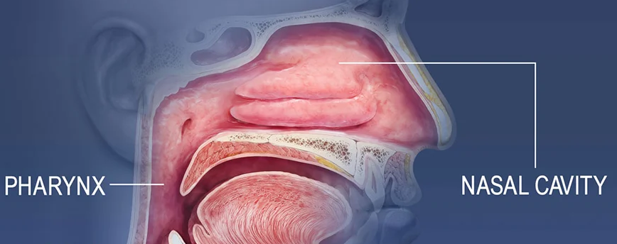
Pharynx
Pharynx aka the throat extends from the nasal cavity to the top of the trachea and oesophagus.
Air travels through it

Slide 12
Trachea
Aka the windpipe because it carries the air into and out of the lungs
Made up of C-shaped cartilage rings that hold the structure open. This ensures air can always pass through
The epithelial lining of the trachea produces mucus, which is able to trap dust and debris, preventing entry into the lungs.

Slide 13
Bronchi
At the end of the trachea, the structure splits into two primary bronchi, one for each lung. These then split further into secondary bronchi which take the air into each lobe of the lung. The secondary bronchi continue to divide, forming tertiary bronchi.
The structure is very similar to the trachea. As the bronchi get smaller, the cartilage is spread out, with smooth muscle and elastin forming more of the structure.
Cilia and mucus work together to trap and remove particles

Slide 14
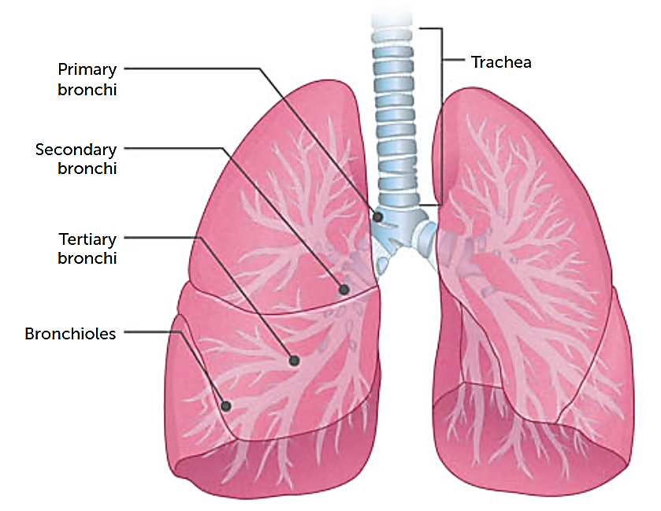

Slide 15
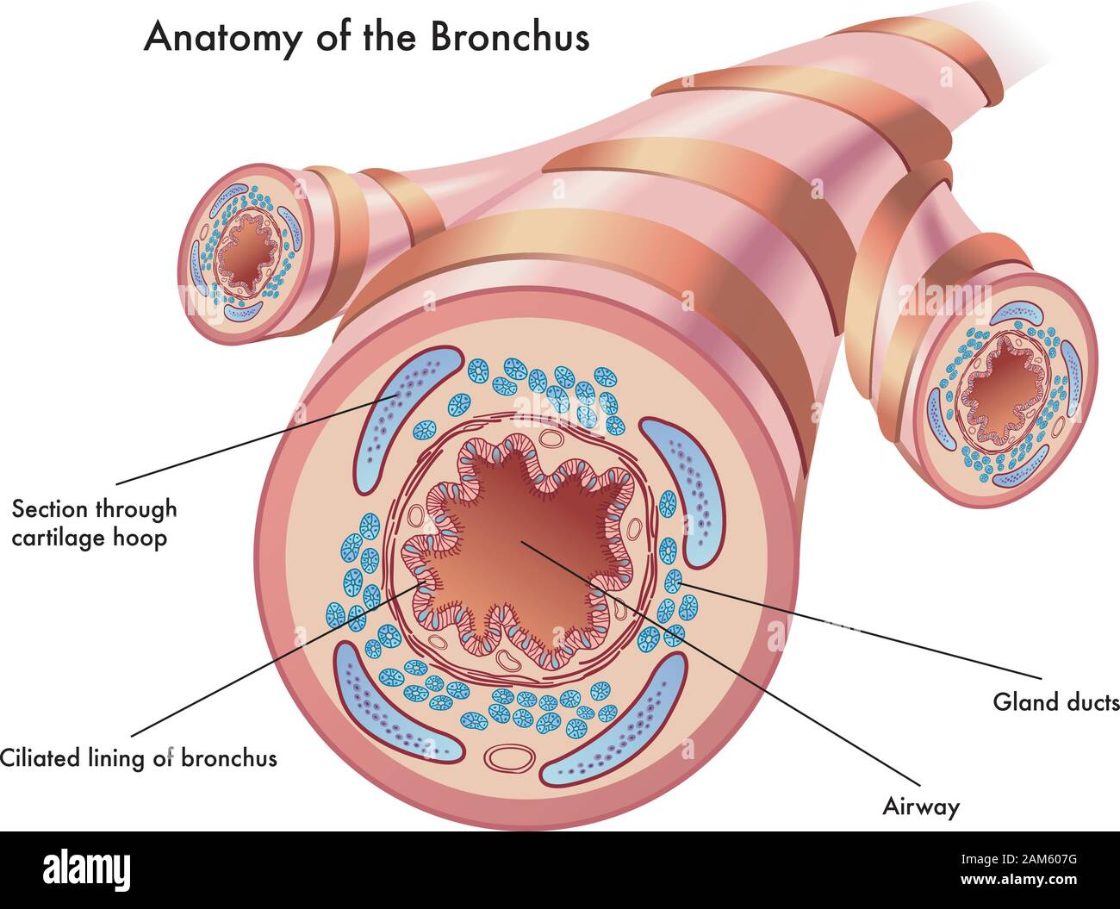

Slide 16
Bronchioles
When the tertiary bronchi divide, they form smaller airways called bronchioles, which continue to split until they end in millions of terminal bronchioles.
Unlike bronchi, bronchioles do not contain cartilage; instead, they are made of smooth muscle and elastin. This allows the bronchioles to control the flow of air into the lungs, expanding when the body needs more oxygen.
Cilia and mucus are also present in the bronchioles, protecting the lungs from contaminants.

Slide 17
Lungs
The two lungs take up most of the chest cavity, except for the space between them occupied by the heart and blood vessels.
Each lung is divided into lobes. The left lung has 2 lobes, the right has 3 lobes.
A membrane called the pleura covers the surface of the lungs and lines the inside of the chest. Between these two layers of membrane is a thin layer of pleural fluid.

Slide 18
Alveoli
Alveoli are tiny air sacs, each with a wall only one cell thick and surrounded by a network of blood capillaries.
This is where gases move between the blood in the capillaries and the air in the alveoli. It is the location of gas exchange, allowing oxygen to pass from the airways into the blood, and carbon dioxide to pass from the blood into the airways.

Slide 19
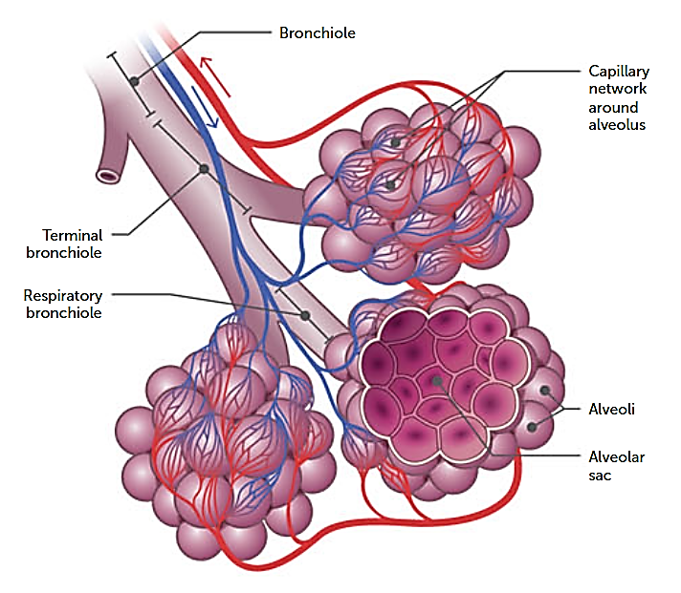

Slide 20
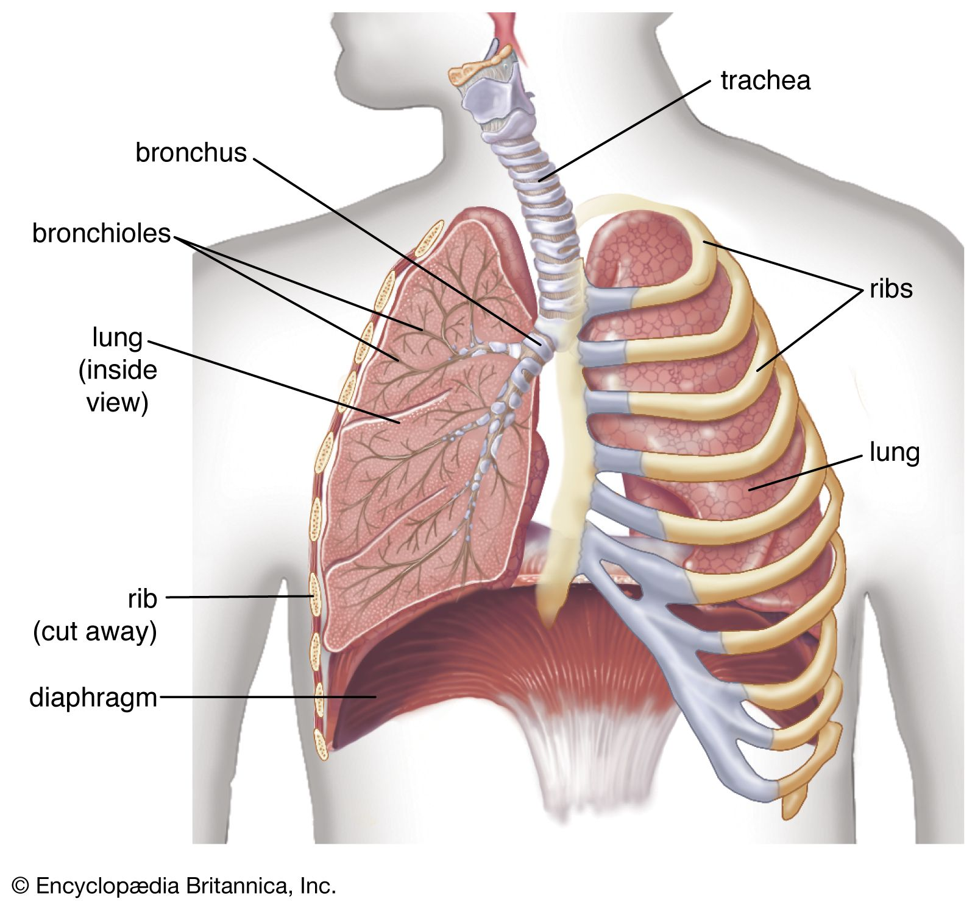
Diaphragm
A muscle that separates the chest from the abdomen. It contracts and flattens downwards, thereby increasing the volume of the chest cavity, and lungs during breathing in.

Slide 21
Ribs
The framework that encompasses the chest.
Protects the lungs

Slide 22
Intercostal muscles
Muscles between the ribs
They move the rib cage upwards and outwards to increase the volume of the chest cavity and thus the lungs when breathing in.

Slide 23
Mechanics of breathing
INSPIRATION:
The process of taking air into the lungs
For air to flow into the lungs, the pressure of air in the lungs must be less than the atmospheric pressure outside the body.
Decreasing the pressure of airs in the lungs is achieved by increasing the volume of lungs
To increase the volume of the lungs, the diaphragm and external intercostal muscles contract.
The diaphragm becomes flatter and the rib cage moves upwards and outwards, lungs expand.

Slide 24
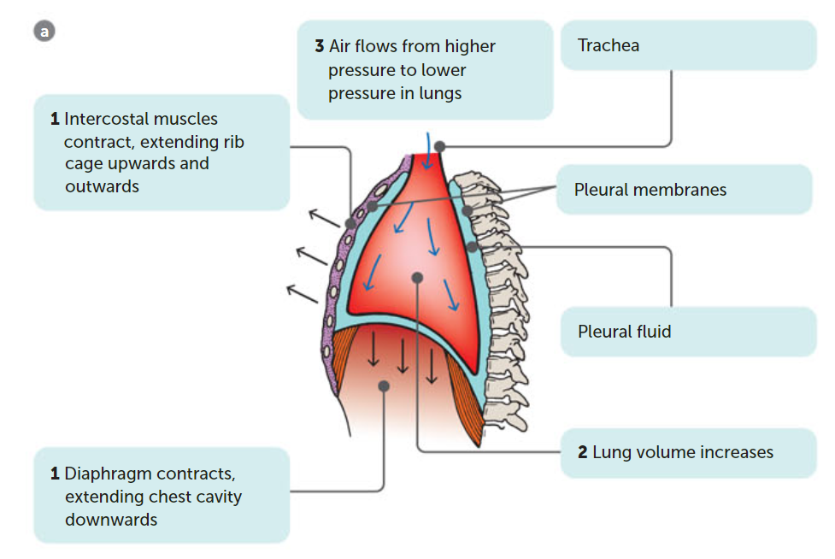
Inspiration Draw it ☺

Slide 25
Mechanics of breathing
EXPIRATION:
The process of removing air from the lungs
The diaphragm and external intercostal muscles relax. The diaphragm bulges and the rib cage moves downwards.
This reduces the volume of the chest cavity and lungs
Air pressure in the lungs is now greater than pressure outside the body

Slide 26
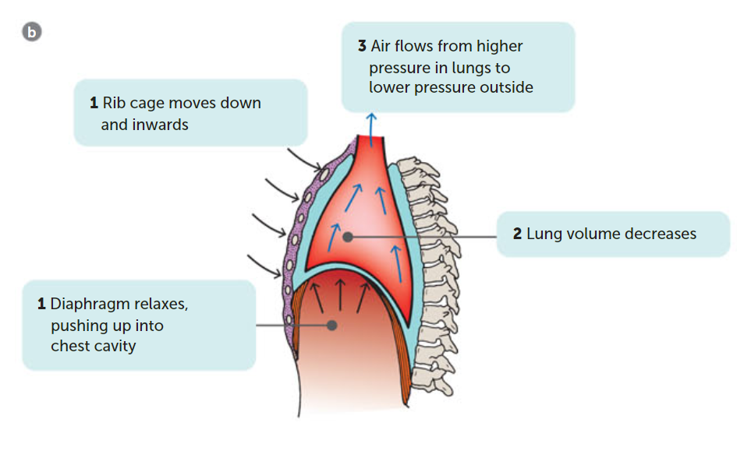
Expiration Draw it ☺

Slide 27
Key concepts so far
The structure of the respiratory system allows the efficient flow of air into and out of the lungs so that gas exchange can occur between the air and the blood
The diaphragm and intercostal muscles work together to change the volume- and therefore pressure- of the lungs, resulting in airflow into or out of the lungs.

Slide 28
Gas Exchange
The lungs are well suited to gas exchange for the following reasons
huge internal surface area (millions of alveoli)
impressive supply of blood vessels. Continuous flow of blood helps to maintain a difference in concentration gradients of oxygen and carbon dioxide
membrane is very thin (1 micrometre thick)
position of lungs is deep inside the body to prevent excessive evaporation
lung volume can be changed

Slide 29
The process of gas exchange
The blood in the capillaries surrounding the alveoli is brought to the lungs by the pulmonary arteries
This blood has been through the capillaries of the body, where much of the oxygen has been taken up the body cells and has a low concentration of oxygen.
Oxygen dissolves in the moisture on the inside of the alveolus and diffuses through the membrane, the walls of the capillaries and into the blood.

Slide 30
The process of gas exchange
The blood arriving at the capillaries of the alveoli has come from the body circulation where it has picked up carbon dioxide produced by respiration in the cells.
The concentration of carbon dioxide in the alveolar capillaries is higher than the concentration in the air in the alveolus. Therefore, carbon dioxide diffused out of the blood and into the air in the alveolus.
 | Inspired Air (%) | Expired Air (%)
Oxygen | 20.95 | 15.80
Carbon Dioxide | 0.04 | 4.30

Slide 31
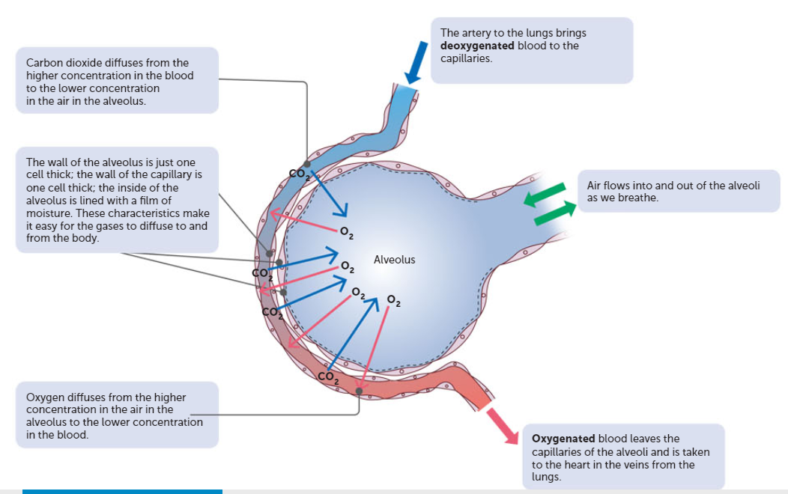
The process of gas exchange
Copy this
☺

Slide 32
The process of gas exchange
For diffusion of gases into and out of the blood, there must be a concentration gradient.
The concentration gradient is maintained by
The constant flow of blood through the capillaries
The movement of air into and out of the alveoli as we breathe in and out.
There is a net diffusion of oxygen into the blood and carbon dioxide out of the blood due to the concentration gradients between the air and blood.

Slide 33
Emphysema
Disease usually caused by long-term exposure to irritating particles in the air taken into the lungs
Some people are at higher risk of emphysema than others e.g. smokers, construction workers
The irritating particles cause damage to alveoli. They lose their elasticity, are often replaced with fibrous tissue, and may break down, reducing the internal surface area of the lung.

Slide 34
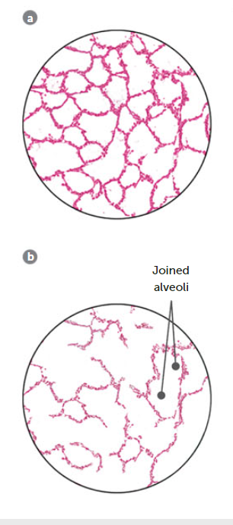
Emphysema
Because of the loss of elasticity of the lung tissue, the lungs are constantly inflated, and breathing out no longer occurs passively but requires voluntary effort
Emphysema cannot be cured, and once lung damage begins, the progression of the disease cannot be stopped.

Slide 35
Lung cancer
Uncontrollable cell growth
Evidence shows clear link between cancer and exposure to asbestos fibres and other pollutants
The bronchi are constantly irritated and the cells lining the mucus membrane start to rapidly divide, becoming a mass.

Slide 36
Lung infections
Pneumonia is an infection caused by bacteria, fungi or other organisms.
The surface area available for exchange of gases is reduced, and breathing difficulty is a symptom of many types of pneumonia.

Slide 37
Recall Knowledge
List the structure that air will travel down, starting from outside the body.
List the characteristics of the lungs that make them well suited for gas exchange
Explain why the pressure in the lungs decreases during inspiration

Slide 38
Apply Knowledge
Why is a concentration gradient important for the exchange of gases?

Slide 39
Homework
Write a summary about how asthma and tuberculosis affects the lungs.

Slide 40
Reading
Pages 86-95 :Chapter 4 - The Respiratory System allows gas exchange

